Slide 1


Slide 2
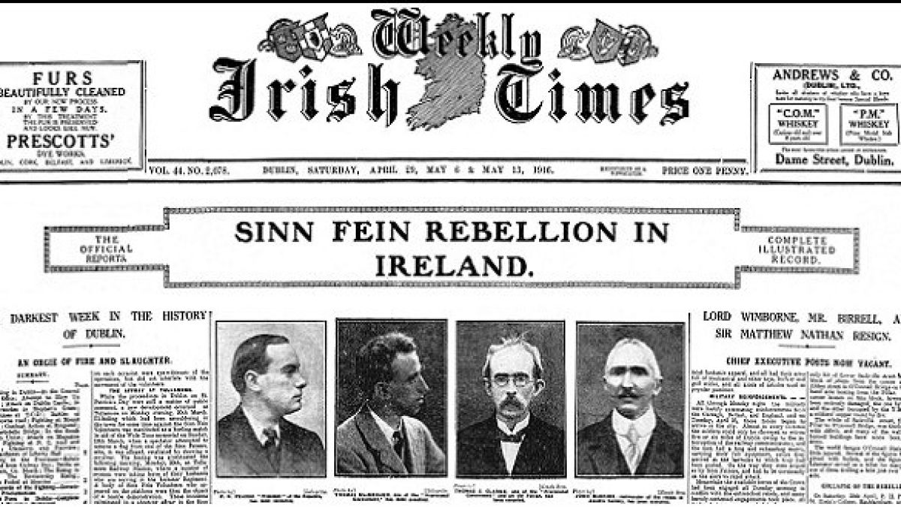
The Irish Times
Sunday 02/01/2022
Edition: 001
“Topic Modeling Of Newspaper Headlines”

Slide 3
Table of Contents
01
04
02
05
03
Sunday 02/01/2022
Edition: 001
Data Description
Our model
Work flow
Rresults
06
In brief
Conclusion

Slide 4
WORK PROCESS
Sunday 02/01/2022
Edition: 001
Divide Data Set
Pre- processing
Data Set pick up
Transformation
Data Modeling

Slide 5

DATA DESCRIPTION
Sunday 02/01/2022
Edition: 001
This news dataset is a composition of 1.61 million headlines posted by the Irish Times .
provides long term birds eye view of the happenings in Europe. The major categories include business, sport, culture, lifestyle and opinion in addition to news.
CSV Records: 1.611.495
1- publish date : Date of the article being published.
2- headline text : Title of the article in UTF-8 charset

Slide 6
In depth
UNDERSTANDING THE PROBLEM
Sunday 02/01/2022
Edition: 001
Categories
Topics
Topic modelling is a classic problem in the domain of natural language processing. Given a corpus of text composed of n documents, the goal is to uncover any latent topic structure that may exist within the data. In other words, we are seeking to discover the set of topics T with which a given series of documents are concerned, and having done so, sort these documents into the differing topic categories.

Slide 7
CHALLENGES
Monday 01/02/2020
Newsletter
Edition: 001
The short text is challenging for the tasks of topic detection and word extraction as it lacks contextual information, which leads to a problem of data sparsity.
One of the most considerable challenges in topic modeling is the issue of configuration.
Prior to running a topic modeling algorithm, data pre-processing should occur, a step from which involves removing stop words and topic general words (TGWs). Topic-general word removal is typically done manually, hence challenging and time-consuming.

Slide 8
PROCESS
Sunday 02/01/2022
Newsletter
Edition: 001
Original Dataset
Get only News
Get only years between 2012 to 2021

Slide 9


Slide 10






PRE_PROCESSING
Sunday 02/01/2022
Newsletter
Edition: 001
Regular Expression/Normalization
Language Detection
(29) languages
Tokenization
Punctuation removal
Stop Words Removal
Change all the text to lower case
Lemmatization & Stemming

Slide 11
TOPIC MODELING
Sunday 02/01/2022
Newsletter
Edition: 001
Latent Dirichlet Allocation (LDA).
Latent Semantic Analysis (LSA)
LSA is quick and efficient to use, but it does have a few primary drawbacks:
* lack of interpretable embeddings (we don’t know what the topics are, and the components may be arbitrarily positive/negative)
* large set of documents and vocabulary to get accurate results
less efficient representation

Slide 12
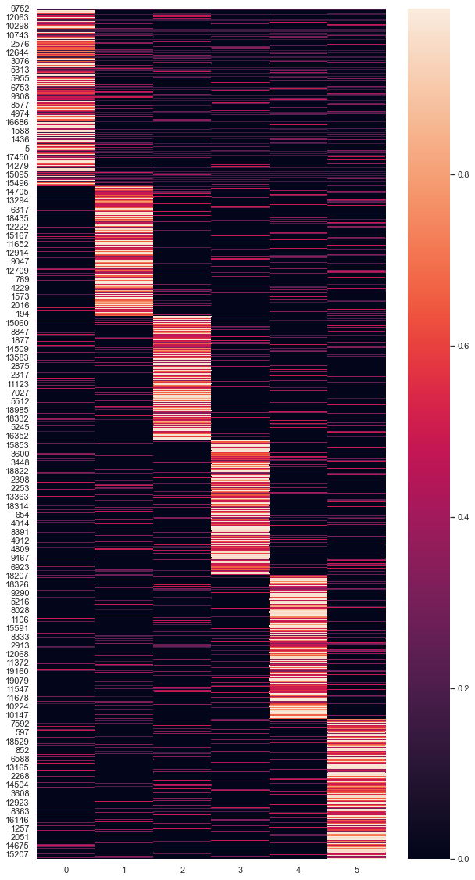
RESULTS
Sunday 02/01/2022
Newsletter
Edition: 001
The distribution of topics in all documents”

Slide 13
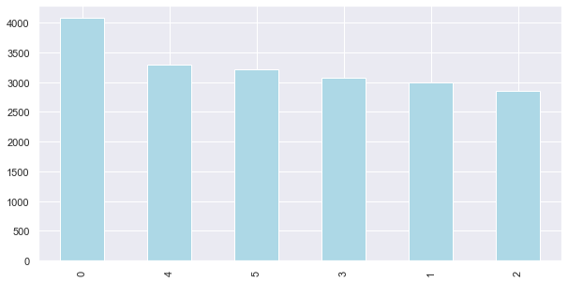
RESULTS
Sunday 02/01/2022
Newsletter
Edition: 001
Word Count and Weights of Topic Keywords

Slide 14
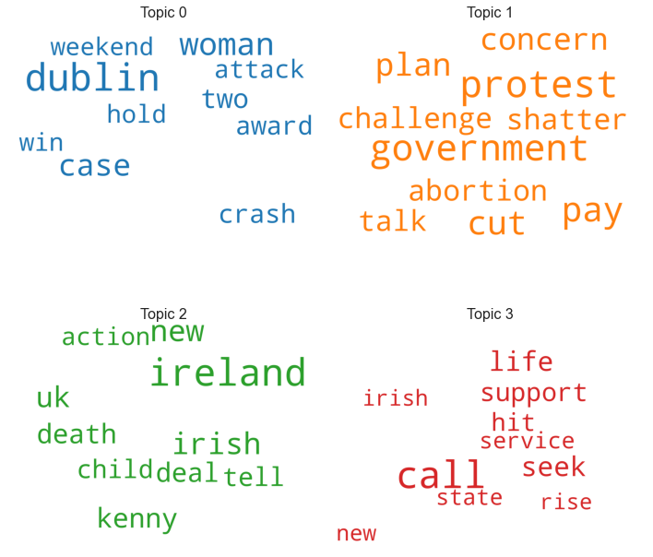
RESULTS
Sunday 02/01/2022
Newsletter
Edition: 001
4 Topics
A sample of our findings

Slide 15
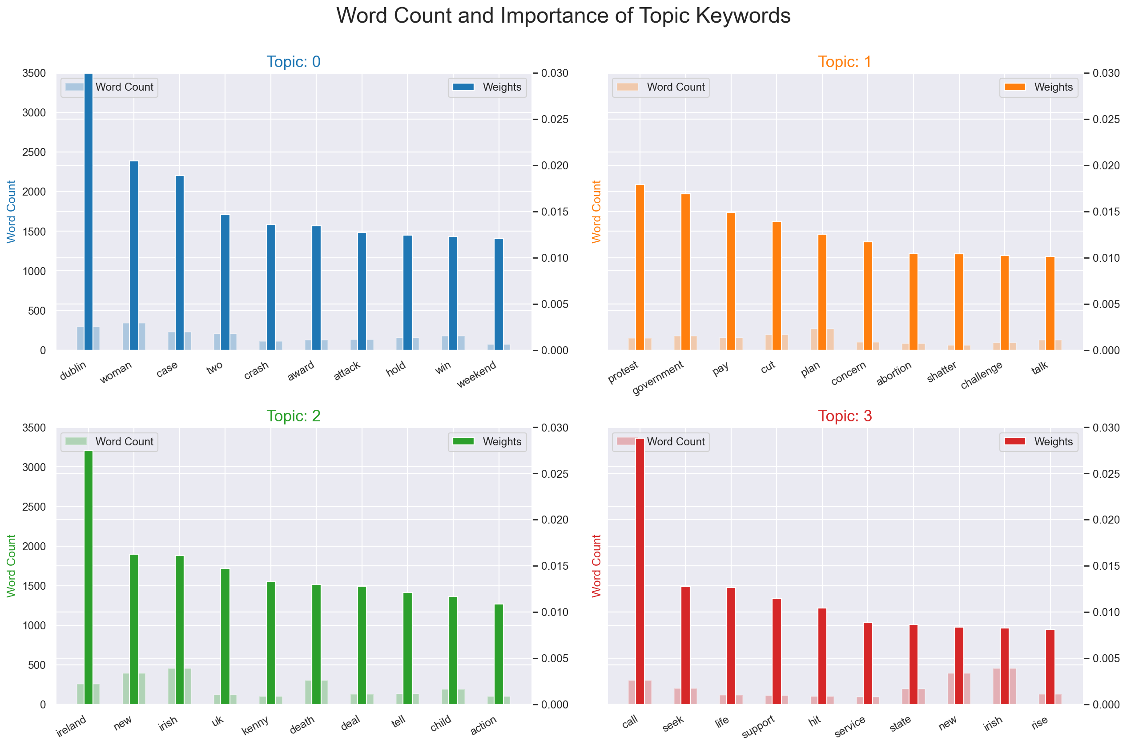
RESULTS
Sunday 02/01/2022
Newsletter
Edition: 001
4 Topics
A sample of our findings

Slide 16
CONCLUSIONS
Sunday 02/01/2022
Edition: 001
LDA can be used consistently and successfully to model text collections of news articles and policy documents.
Generally, a dataset is unsuitable for topic modeling if the length of the documents is too short.

Slide 17

UPCOMING GOALS
Sunday 02/01/2022
Newsletter
Edition: 001

Slide 18
Thanks
Newsletter
Edition: 001
Prepared by:
FAISAL ALJOWAIE
FAHAD ALOMRAN
ABDULLAH ALMORISHED
ALYA ALMANQOUR

